Slide 1
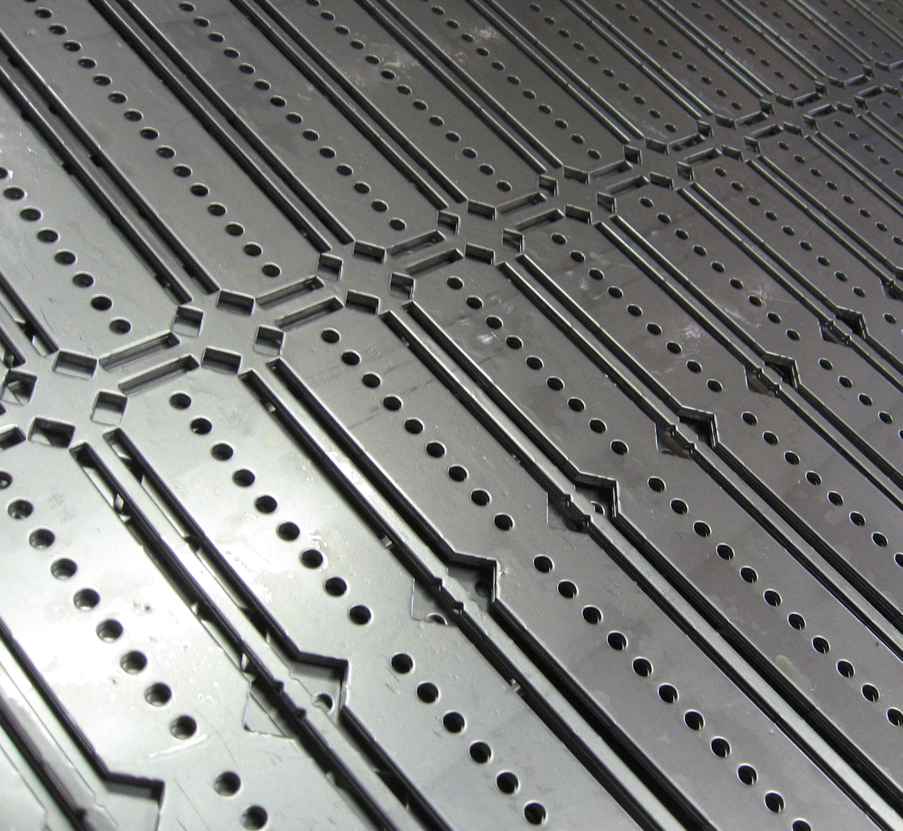
Sheet Metal Part
Presenter
Developer Technical Services

Slide 2
Agenda
SheetMetal Document
SheetMetal Styles
SheetMetal Features
Access to the FlatPattern
FlatPattern Information: Bends & Punches
FlatPattern Export

Slide 3
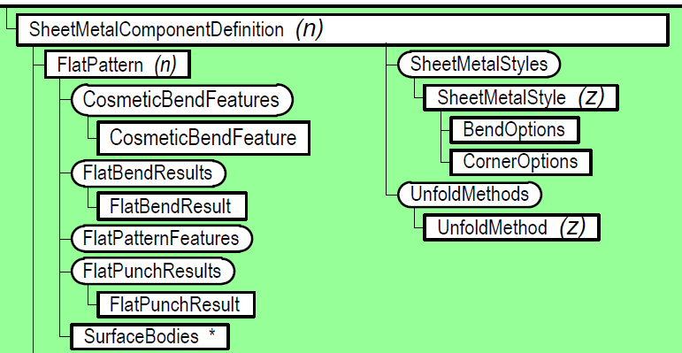
Sheet Metal Document
Is a PartDocument with SheetMetalComponentDefinition derived from PartComponentDefinition.
Provides access to sheet metal specific settings, sheet metal styles, sheet metal features in addition to all the part features.
Provides access to the folded and the flat versions of the model.
Provides access to the bend, punch and cosmetic bend information in the flat.

Slide 4
How to recognize a SheetMetal Part ?
Public Sub IsSheetMetalPart()
Dim doc As PartDocument
doc = _InvApplication.ActiveDocument
If (doc.SubType = "{9C464203-9BAE-11D3-8BAD-0060B0CE6BB4}") Then
MsgBox("Document is a Sheet Metal Part :)")
Else
MsgBox("Document is a regular Part :(")
End If
End Sub
' Create a new sheet metal document, using the sheet metal template.
Dim oSheetMetalDoc As PartDocument
oSheetMetalDoc = _InvApplication.Documents.Add(DocumentTypeEnum.kPartDocumentObject, _
_InvApplication.FileManager.GetTemplateFile(_
DocumentTypeEnum.kPartDocumentObject, _
SystemOfMeasureEnum.kDefaultSystemOfMeasure, _
DraftingStandardEnum.kDefault_DraftingStandard, _
"{9C464203-9BAE-11D3-8BAD-0060B0CE6BB4}"))

Slide 5
Sheet Metal Styles
Sheet metal styles and unfold methods provide a way of defining and saving various settings.
Activating a sheet metal style causes the values defined in the style to be applied to the sheet metal document.
These values are accessed through the SheetMetalStyle object using its properties:
BendRadius, BendReliefDepth, BendReliefWidth, CornerReliefSize, GapSize, Thickness, …
These properties are get/set as String
Notes:
'/////////////////////////////////////////////////////////////////////////////////////////////////////////////
'// Use:
'// [Sheet Metal Style Creation Example (Visual Basic)]
'// This sample illustrates creating a new sheet metal style.
'// It uses a sample bend table delivered with Inventor. You can
'// edit the path below to reference any existing bend table.
'// To use the sample make sure a bend table is available at the
'// specified path, open a sheet metal document, and run the sample.
'/////////////////////////////////////////////////////////////////////////////////////////////////////////////
Public Sub CreateSheetMetalStyle()
' Set a reference to the sheet metal document.
' This assumes a part document is active.
Dim oPartDoc As PartDocument
oPartDoc = _InvApplication.ActiveDocument
' Make sure the document is a sheet metal document.
If oPartDoc.SubType <> "{9C464203-9BAE-11D3-8BAD-0060B0CE6BB4}" Then
MsgBox("A sheet metal document must be open.")
Exit Sub
End If
' Get the sheet metal component definition. Because this is a part document whose
' sub type is sheet metal, the document will return a SheetMetalComponentDefinition
' instead of a PartComponentDefinition.
Dim oSheetMetalCompDef As SheetMetalComponentDefinition
oSheetMetalCompDef = oPartDoc.ComponentDefinition
' Copy a sheet metal style to create a new one. There will always be at least
' one style in a document. This sample uses the first style, which is the default.
Dim oStyle As SheetMetalStyle
Try
oStyle = oSheetMetalCompDef.SheetMetalStyles.Copy(oSheetMetalCompDef.SheetMetalStyles.Item(1), "Custom Style")
Catch
MsgBox("Custom Style already exists :(")
Exit Sub
End Try
' Get the name of the parameter used for the thickness. We need the actual name
' to use in expressions to set the other values. It's best to get the name rather
' than hard code it because the name changes with various languages and the user
' can change the name in the Parameters dialog.
' This gets the name of the thickness from the component definition.
Dim sThicknessName As String
sThicknessName = oSheetMetalCompDef.Thickness.Name
' Set the various values associated with the style.
oStyle.BendRadius = sThicknessName & " * 1.5"
oStyle.BendReliefWidth = sThicknessName & " / 2"
oStyle.BendReliefDepth = sThicknessName & " * 1.5"
oStyle.CornerReliefSize = sThicknessName & " * 2.0"
oStyle.MinimumRemnant = sThicknessName & " * 2.0"
oStyle.BendReliefShape = BendReliefShapeEnum.kRoundBendReliefShape
oStyle.BendTransition = BendTransitionEnum.kArcBendTransition
oStyle.CornerReliefShape = CornerReliefShapeEnum.kRoundCornerReliefShape
' Add a linear unfold method. Unfold methods are now separate
' from sheet metal styles.
Try
oSheetMetalCompDef.UnfoldMethods.AddLinearUnfoldMethod("Linear Sample", "0.43")
Catch
MsgBox("Linear Sample UnfoldMethod already exists :(")
Exit Sub
End Try
' Add a bend table fold method. This uses error trapping to catch if an
' invalid bend table file was specified.
Try
Call oSheetMetalCompDef.UnfoldMethods.AddBendTableFromFile("Table Sample", OpenFile("Bend Table (*.txt)|*.txt"))
Catch
MsgBox("Unable to load bend table")
End Try
' Make the new linear method the active unfold method for the document.
Dim oUnfoldMethod As UnfoldMethod
oUnfoldMethod = oSheetMetalCompDef.UnfoldMethods.Item("Linear Sample")
oStyle.UnfoldMethod = oUnfoldMethod
' Activate this style, which will also update the part.
oStyle.Activate()
End Sub
'/////////////////////////////////////////////////////////////////////////////////////////////////////////////
'// Use:
'// This sample illustrates getting information about sheet metal styles,
'// unfold methods, and thickness.
'/////////////////////////////////////////////////////////////////////////////////////////////////////////////
Public Sub SheetMetalStyleDisplay()
' Set a reference to the sheet metal document.
' This assumes a part document is active.
Dim oPartDoc As PartDocument
oPartDoc = _InvApplication.ActiveDocument
' Make sure the document is a sheet metal document.
If oPartDoc.SubType <> "{9C464203-9BAE-11D3-8BAD-0060B0CE6BB4}" Then
MsgBox("A sheet metal document must be open.")
Exit Sub
End If
' Get the sheet metal component definition. Because this is a part document whose
' sub type is sheet metal, the document will return a SheetMetalComponentDefinition
' instead of a PartComponentDefinition.
Dim oSheetMetalCompDef As SheetMetalComponentDefinition
oSheetMetalCompDef = oPartDoc.ComponentDefinition
' Iterate through the sheet metal styles.
Dim oStyle As SheetMetalStyle
For Each oStyle In oSheetMetalCompDef.SheetMetalStyles
' Display information about the style.
If oStyle Is oSheetMetalCompDef.ActiveSheetMetalStyle Then
Debug.Print("** Active SheetMetal Style **")
End If
Debug.Print("Name: " & oStyle.Name)
Debug.Print(" Bend Radius: " & oStyle.BendRadius)
Debug.Print(" Bend Relief Depth: " & oStyle.BendReliefDepth)
Debug.Print(" Bend Relief Width: " & oStyle.BendReliefWidth)
Select Case oStyle.BendReliefShape
Case BendReliefShapeEnum.kDefaultBendReliefShape
Debug.Print(" Bend Relief Shape: Default")
Case BendReliefShapeEnum.kRoundBendReliefShape
Debug.Print(" Bend Relief Shape: Round")
Case BendReliefShapeEnum.kStraightBendReliefShape
Debug.Print(" Bend Relief Shape: Straight")
Case BendReliefShapeEnum.kTearBendReliefShape
Debug.Print(" Bend Relief Shape: Tear")
End Select
Select Case oStyle.BendTransition
Case BendTransitionEnum.kDefaultBendTransition
Debug.Print(" Bend Transition: Default")
Case BendTransitionEnum.kArcBendTransition
Debug.Print(" Bend Transition: Arc")
Case BendTransitionEnum.kIntersectionBendTransition
Debug.Print(" Bend Transition: Intersection")
Case BendTransitionEnum.kNoBendTransition
Debug.Print(" Bend Transition: No Bend")
Case BendTransitionEnum.kStraightLineBendTransition
Debug.Print(" Bend Transition: Straight Line")
Case BendTransitionEnum.kTrimToBendBendTransition
Debug.Print(" Bend Transition: Trom to Bend")
End Select
Select Case oStyle.CornerReliefShape
Case CornerReliefShapeEnum.kDefaultCornerReliefShape
Debug.Print(" Corner Relief Shape: Default")
Case CornerReliefShapeEnum.kRoundCornerReliefShape
Debug.Print(" Corner Relief Shape: Round")
Case CornerReliefShapeEnum.kSquareCornerReliefShape
Debug.Print(" Corner Relief Shape: Square")
Case CornerReliefShapeEnum.kTearCornerReliefShape
Debug.Print(" Corner Relief Shape: Tear")
Case CornerReliefShapeEnum.kArcWeldCornerReliefShape
Debug.Print(" Corner Relief Shape: Arc Weld")
Case CornerReliefShapeEnum.kFullRoundCornerReliefShape
Debug.Print(" Corner Relief Shape: Full Found")
Case CornerReliefShapeEnum.kIntersectionCornerReliefShape
Debug.Print(" Corner Relief Shape: Intersection")
Case CornerReliefShapeEnum.kLinearWeldReliefShape
Debug.Print(" Corner Relief Shape: Linear Weld")
Case CornerReliefShapeEnum.kTrimToBendReliefShape
Debug.Print(" Corner Relief Shape: Trim to Bend")
Case CornerReliefShapeEnum.kNoReplacementCornerReliefShape
Debug.Print(" Corner Relief Shape: No Replacement")
Case CornerReliefShapeEnum.kRoundWithRadiusCornerReliefShape
Debug.Print(" Corner Relief Shape: Round with Radius")
End Select
Debug.Print(" Corner Relief Size: " & oStyle.CornerReliefSize)
Debug.Print(" Minimum Remnant: " & oStyle.MinimumRemnant)
Debug.Print(" Thickness: " & oStyle.Thickness)
Debug.Print(" -------------------------- ")
Next
' Display information about the unfold methods.
Debug.Print("")
Debug.Print("Unfold Methods")
Dim oUnfoldMethod As UnfoldMethod
For Each oUnfoldMethod In oSheetMetalCompDef.UnfoldMethods
Debug.Print(" " & oUnfoldMethod.Name)
Select Case oUnfoldMethod.UnfoldMethodType
Case UnfoldMethodTypeEnum.kBendTableUnfoldMethod
Debug.Print(" Unfold Method Type: Bend Table")
Case UnfoldMethodTypeEnum.kLinearUnfoldMethod
Debug.Print(" Unfold Method Type: Linear")
Debug.Print(" Value: " & oUnfoldMethod.kFactor)
Case UnfoldMethodTypeEnum.kCustomEquationUnfoldMethod
Debug.Print(" Unfold Method Type: Custom Equation")
End Select
Debug.Print(" -------------------------- ")
Next
End Sub
'/////////////////////////////////////////////////////////////////////////////////////////////////////////////
'// Use: This sample illustrates editing the thickness of a sheet metal part
'//
'/////////////////////////////////////////////////////////////////////////////////////////////////////////////
Public Sub SetSheetMetalThickness()
' Set a reference to the sheet metal document.
' This assumes a sheet metal document is active.
Dim oPartDoc As PartDocument
oPartDoc = _InvApplication.ActiveDocument
' Get the sheet metal component definition. Because this is a part document whose
' sub type is sheet metal, the document will return a SheetMetalComponentDefinition
' instead of a PartComponentDefinition.
Dim oSheetMetalCompDef As SheetMetalComponentDefinition
oSheetMetalCompDef = oPartDoc.ComponentDefinition
' Change Thickness
oSheetMetalCompDef.ActiveSheetMetalStyle.Thickness = "0.50 in"
' Update the part.
_InvApplication.ActiveDocument.Update()
End Sub

Slide 6
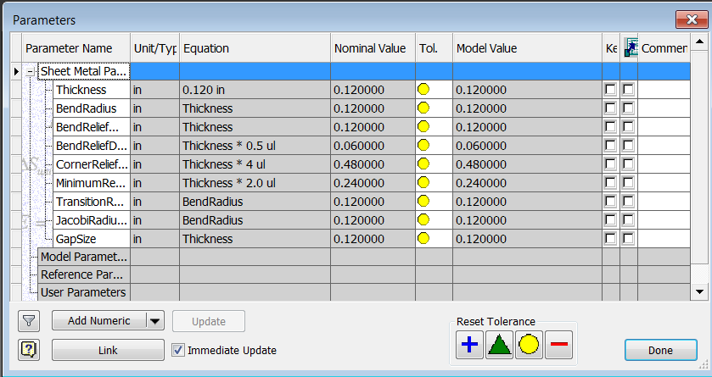
Sheet Metal Style and Parameters
Many of the SheetMetalStyle properties are used to set the value of reference parameters. Read-only parameters since they are defined by the style value:
Those Parameters can be directly Accessed from the SheetMetalComponentDefinition properties.

Slide 7
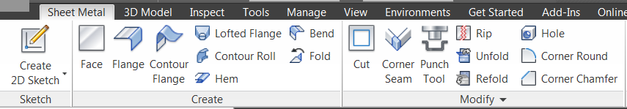
Sheet Metal Features
The SheetMetalComponentDefinition.Features property returns the SheetMetalFeatures collection object. It Derives from PartFeatures.
It provides support for the various sheet metal features.
Complete query is available for all of the sheet metal features. Creation is supported for most of them.
All sheet metal features use the “definition” concept where there’s an associated definition object that defines the information specific to that type of feature.
Notes:
Have full query access to all sheet metal features. Even though this is limited to query it’s still possible to perform some limited edits because the query functions provide access to the associated parameters and their values can be edited.
Support for the creation of Face and Cut features. Because Face features will create automatic bends where the face butts up to an existing model, it’s possible to get some bends as a side effect. This is demonstrated with the sample FaceAndCutFeatureCreation
'/////////////////////////////////////////////////////////////////////////////////////////////////////////////
'// Use:
'// This sample demonstrates the creation of sheet metal face and cut features.
'// It creates a new sheet metal document, create a face feature, a cut feature
'// and another face feature. The second face feature butts up to the first
'// face feature so it automatically creates a bend between them.
'//
'/////////////////////////////////////////////////////////////////////////////////////////////////////////////
Public Sub FaceAndCutFeatureCreation()
' Create a new sheet metal document, using the default sheet metal template.
Dim oSheetMetalDoc As PartDocument
oSheetMetalDoc = _InvApplication.Documents.Add(DocumentTypeEnum.kPartDocumentObject, _
_InvApplication.FileManager.GetTemplateFile(DocumentTypeEnum.kPartDocumentObject, _
SystemOfMeasureEnum.kDefaultSystemOfMeasure, _
DraftingStandardEnum.kDefault_DraftingStandard, _
"{9C464203-9BAE-11D3-8BAD-0060B0CE6BB4}"))
' Set a reference to the component definition.
Dim oCompDef As SheetMetalComponentDefinition
oCompDef = oSheetMetalDoc.ComponentDefinition
' Set a reference to the sheet metal features collection.
Dim oSheetMetalFeatures As SheetMetalFeatures
oSheetMetalFeatures = oCompDef.Features
' Create a new sketch on the X-Y work plane.
Dim oSketch As PlanarSketch
oSketch = oCompDef.Sketches.Add(oCompDef.WorkPlanes.Item(3))
' Set a reference to the transient geometry object.
Dim oTransGeom As TransientGeometry
oTransGeom = _InvApplication.TransientGeometry
' Draw a 20cm x 15cm rectangle with the corner at (0,0)
Call oSketch.SketchLines.AddAsTwoPointRectangle( _
oTransGeom.CreatePoint2d(0, 0), _
oTransGeom.CreatePoint2d(20, 15))
' Create a profile.
Dim oProfile As Profile
oProfile = oSketch.Profiles.AddForSolid
Dim oFaceFeatureDefinition As FaceFeatureDefinition
oFaceFeatureDefinition = oSheetMetalFeatures.FaceFeatures.CreateFaceFeatureDefinition(oProfile)
' Create a face feature.
Dim oFaceFeature As FaceFeature
oFaceFeature = oSheetMetalFeatures.FaceFeatures.Add(oFaceFeatureDefinition)
' Get the top face for creating the new sketch.
Dim aSelectTypes(0) As SelectionFilterEnum
aSelectTypes(0) = SelectionFilterEnum.kPartFaceFilter
Dim oFoundFaces As ObjectsEnumerator
oFoundFaces = oCompDef.FindUsingPoint(oTransGeom.CreatePoint(1, 1, oCompDef.Thickness.Value), aSelectTypes, 0.001)
Dim oFrontFace As Face
oFrontFace = oFoundFaces.Item(1)
' Create a new sketch on this face, but use the method that allows you to
' control the orientation and orgin of the new sketch.
oSketch = oCompDef.Sketches.Add(oFrontFace)
' Create the interior 3cm x 2cm rectangle for the cut.
Call oSketch.SketchLines.AddAsTwoPointRectangle( _
oTransGeom.CreatePoint2d(2, 5.5), _
oTransGeom.CreatePoint2d(5, 11))
' Create a profile.
oProfile = oSketch.Profiles.AddForSolid
' Create a cut definition object
Dim oCutDefinition As CutDefinition
oCutDefinition = oSheetMetalFeatures.CutFeatures.CreateCutDefinition(oProfile)
' Set extents to 'Through All'
Call oCutDefinition.SetThroughAllExtent(PartFeatureExtentDirectionEnum.kNegativeExtentDirection)
' Create the cut feature
Dim oCutFeature As CutFeature
oCutFeature = oSheetMetalFeatures.CutFeatures.Add(oCutDefinition)
' Create a new sketch on the X-Z work plane.
oSketch = oCompDef.Sketches.Add(oCompDef.WorkPlanes.Item(2))
' Draw a 15cm x 10cm rectangle with the corner at (0,0)
Call oSketch.SketchLines.AddAsTwoPointRectangle( _
oTransGeom.CreatePoint2d(0, 0), _
oTransGeom.CreatePoint2d(-15, 10))
' Create a profile.oBendEdgesoBendEdges
oProfile = oSketch.Profiles.AddForSolid
oFaceFeatureDefinition = oSheetMetalFeatures.FaceFeatures.CreateFaceFeatureDefinition(oProfile)
' Create a face feature.
oFaceFeature = oSheetMetalFeatures.FaceFeatures.Add(oFaceFeatureDefinition)
End Sub

Slide 8
Sheet Metal Features
Full support for the new Unfold and Refold features.
Creation support for Bend, Contour Flange, Corner Chamfer, Corner, Corner Round, and Hem.
Basic support for the new sheet metal features: Contour Roll, Lofted Flange, Rip, and Cosmetic bend.
Query/Edit order of bends in flat pattern.
Support for equations in unfold rules.
Notes:
We’ve continued to fill in the gaps in the Sheet Metal API. On the RibbonBar screenshot, I’ve outlined the features we supported up to now in green, and the features we’re introducing support for in 2010 in red.
We’ve got full API support for the new Unfold and Refold feature – that’s creation, editing and querying.
We’ve added creation support for Bend, Contour Flange, Corner Chamfer, Corner, Corner Round, and Hem. Previously these were query only.
We have basic support for the new Contour Roll, Lofted Flange, Rip, and Cosmetic bend features.
In the flat panel, there’s a new command where you can edit the order of the bend operations. You can do the same in the API.
We have an API support for equations in unfold rules..
And you’ve been able to model in the flat panel environment for about two releases now. Now you can do it in the API as well.
'/////////////////////////////////////////////////////////////////////////////////////////////////////////////
'// Use: The Unfold and Refold feature related calls are new in Inventor 2010
'//
'/////////////////////////////////////////////////////////////////////////////////////////////////////////////
Public Sub FoldPart()
' Set a reference to the sheet metal document.
' This assumes a part document is active.
Dim oPartDoc As PartDocument
oPartDoc = _InvApplication.ActiveDocument
' Make sure the document is a sheet metal document.
If oPartDoc.SubType <> "{9C464203-9BAE-11D3-8BAD-0060B0CE6BB4}" Then
MsgBox("A sheet metal document must be open.")
Exit Sub
End If
Dim sheetMetalDef As SheetMetalComponentDefinition
sheetMetalDef = oPartDoc.ComponentDefinition
' Look at the face for a planar face that lies on the X-Y plane.
Dim face As Face
Dim baseFace As Face
baseFace = Nothing
For Each face In sheetMetalDef.SurfaceBodies.Item(1).Faces
If face.SurfaceType = SurfaceTypeEnum.kPlaneSurface Then
If System.Math.Round(face.PointOnFace.Z, 7) = 0 Then
baseFace = face
Exit For
End If
End If
Next
Dim sheetMetalFeatures As SheetMetalFeatures
sheetMetalFeatures = sheetMetalDef.Features
' Check to see if a base found was found.
If Not baseFace Is Nothing Then
' Unfold all of the bends so the part is flat.
Dim unfoldFeature As UnfoldFeature
unfoldFeature = sheetMetalFeatures.UnfoldFeatures.Add(baseFace)
'MsgBox "Part unfolded."
' Refold each bend, one at a time.
Dim i As Integer
For i = 1 To sheetMetalDef.Bends.Count
'MsgBox "Refolding bend " & i & " of " & sheetMetalDef.bends.count
' Add the bend to an ObjectCollection.
Dim bends As ObjectCollection
bends = _InvApplication.TransientObjects.CreateObjectCollection
Call bends.Add(sheetMetalDef.Bends.Item(i))
' Create the refold feature.
Call sheetMetalFeatures.RefoldFeatures.Add(unfoldFeature.StationaryFace, bends)
Next
End If
End Sub

Slide 9
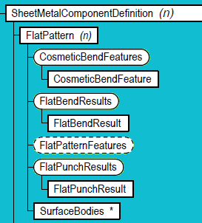
Sheet Metal FlatPattern Access
Determine if a flat pattern exists.
SheetMetalComponentDefinition.HasFlatPattern
Create the flat pattern.
SheetMetalComponentDefinition.Unfold and Unfold2
Delete the flat pattern.
FlatPattern.Delete and FlatPattern.DeleteObjects
Enter and exit edit mode within the user interface.
FlatPattern.Edit, FlatPattern.ExitEdit
Control the orientation of the flat pattern.
FlatPattern.FlipBaseFace, FlatPattern.GetAlignment,
FlatPattern.SetAlignment
Full modeling support in the FlatPattern environment: Access to the Features, Sketches and WorkFeatures.

Slide 10
Access to the Flat Model
Access the B-Rep of the flat pattern.
FlatPattern.SurfaceBody
Get flat pattern extents.
FlatPattern.Length, FlatPattern.Width
Get top and bottom faces of the flat pattern.
FlatPattern.TopFace, FlatPattern.BottomFace
The Face.CreatedByFeature property works for faces in the flat pattern and will return the feature that caused that face to be created.
The FlatPattern.GetFlatPatternEntity method takes a B-Rep entity from the folded model (Vertex, Edge, or Face) and provides the equivalent entity, (if it exists), in the flat pattern.

Slide 11
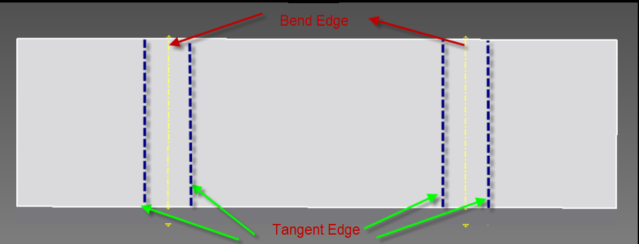
Access to Flat Pattern Bend Information
Get the bend and fold lines from the flat pattern. The EdgeType argument allows you to specify what you want (fold down bend lines, fold up bend lines, or tangent lines).
FlatPattern.GetEdgesOfType( EdgeType As FlatPatternEdgeTypeEnum, _ [TopFaceEdges As Boolean = True]) As Edges
Bend and tangent lines are represented as Edge objects. These Edge objects represent wireframe edges and are not associated with a surface or solid. For wireframe edges, the Wire Property on the Edge will return a Wire object, indicating it is a wireframe edge.
The FlatPattern.FlatBendResults provides access to the bend information, (number of bends, bend up or down, bend angle, inside radius, etc.), and the associated Edge that represents the bend.
Notes:
'/////////////////////////////////////////////////////////////////////////////////////////////////////////////
'// Use: Gets Flat bend info for active doc
'//
'/////////////////////////////////////////////////////////////////////////////////////////////////////////////
Public Sub GetBendResults()
' Set a reference to the sheet metal document.
' This assumes a part document is active.
Dim oPartDoc As PartDocument
oPartDoc = _InvApplication.ActiveDocument
' Make sure the document is a sheet metal document.
If oPartDoc.SubType <> "{9C464203-9BAE-11D3-8BAD-0060B0CE6BB4}" Then
MsgBox("A sheet metal document must be open.")
Exit Sub
End If
Dim oSheetMetalCompDef As SheetMetalComponentDefinition
oSheetMetalCompDef = oPartDoc.ComponentDefinition
If (Not oSheetMetalCompDef.HasFlatPattern) Then
oSheetMetalCompDef.Unfold()
End If
Dim oFlatPattern As FlatPattern
oFlatPattern = oSheetMetalCompDef.FlatPattern
Dim oBendResult As FlatBendResult
For Each oBendResult In oFlatPattern.FlatBendResults
Dim strResult As String
strResult = "Internal Name: " & oBendResult.InternalName & ", "
If oBendResult.IsOnBottomFace Then
strResult = strResult & "On Bottom, "
Else
strResult = strResult & "On Top, "
End If
strResult = strResult & "Angle: " & _InvApplication.ActiveDocument.UnitsOfMeasure.GetStringFromValue(oBendResult.Angle, UnitsTypeEnum.kDefaultDisplayAngleUnits) & ", "
strResult = strResult & "Inner Radius: " & _InvApplication.ActiveDocument.UnitsOfMeasure.GetStringFromValue(oBendResult.InnerRadius, UnitsTypeEnum.kDefaultDisplayLengthUnits) & ", "
If oBendResult.IsDirectionUp Then
strResult = strResult & "Bend Direction: " & "Bend Up"
Else
strResult = strResult & "Bend Direction: " & "Bend Down"
End If
Debug.Print(strResult)
Next
End Sub
'User has to select a bend line in a drawing document
'that belongs to the flat bend pattern of a SheetMetalPart
Public Sub GetBendResultFromSelectedCurve()
'Gets the selected curve segment
Dim oDwCurveSegment As DrawingCurveSegment
oDwCurveSegment = _InvApplication.ActiveDocument.SelectSet.Item(1)
'Gets full drawing curve from the segment
Dim oDrawingCurve As DrawingCurve
oDrawingCurve = oDwCurveSegment.Parent
'Gets edge
Dim oEdge As Edge
oEdge = oDrawingCurve.ModelGeometry
'Retrieves component definition from the edge
Dim oSMDef As SheetMetalComponentDefinition
oSMDef = oEdge.Parent.ComponentDefinition
Dim oFlatPattern As FlatPattern
oFlatPattern = oSMDef.FlatPattern
'Gets flat bend result corresponding to the edge
Dim oBendResult As FlatBendResult
oBendResult = oFlatPattern.FlatBendResults.Item(oEdge)
'Prints Flat Bend Results
Debug.Print("---------------- Flat Bend Infos ----------------")
Debug.Print("Internal Name: " & oBendResult.InternalName)
If oBendResult.IsOnBottomFace Then
Debug.Print("Bend On Bottom Face")
Else
Debug.Print("Bend On Top Face")
End If
Debug.Print("Bend Angle = " & _InvApplication.ActiveDocument.UnitsOfMeasure.GetStringFromValue(oBendResult.Angle, UnitsTypeEnum.kDefaultDisplayAngleUnits))
Debug.Print("Bend Radius = " & _InvApplication.ActiveDocument.UnitsOfMeasure.GetStringFromValue(oBendResult.InnerRadius, UnitsTypeEnum.kDefaultDisplayLengthUnits))
If oBendResult.IsDirectionUp Then
Debug.Print("Bend Direction: " & "Bend Up")
Else
Debug.Print("Bend Direction: " & "Bend Down")
End If
Debug.Print("-------------------------------------------------")
End Sub
Public Sub GetBendLines()
Dim oSheetMetalCompDef As SheetMetalComponentDefinition
oSheetMetalCompDef = _InvApplication.ActiveDocument.ComponentDefinition
Dim oFlatPattern As FlatPattern
oFlatPattern = oSheetMetalCompDef.FlatPattern
Dim oBendResults As FlatBendResults
oBendResults = oFlatPattern.FlatBendResults
Debug.Print("Nb. Bend Lines = " & oBendResults.Count / 2)
Dim oBendResult As FlatBendResult
For Each oBendResult In oBendResults
Debug.Print("---------------- Flat Bend Infos ----------------")
Debug.Print("Internal Name: " & oBendResult.InternalName)
If oBendResult.IsOnBottomFace Then
Debug.Print("Bend On Bottom Face")
Else
Debug.Print("Bend On Top Face")
End If
Debug.Print("Bend Angle = " & _InvApplication.ActiveDocument.UnitsOfMeasure.GetStringFromValue(oBendResult.Angle, UnitsTypeEnum.kDefaultDisplayAngleUnits))
Debug.Print("Bend Radius = " & _InvApplication.ActiveDocument.UnitsOfMeasure.GetStringFromValue(oBendResult.InnerRadius, UnitsTypeEnum.kDefaultDisplayLengthUnits))
If oBendResult.IsDirectionUp Then
Debug.Print("Bend Direction: " & "Bend Up")
Else
Debug.Print("Bend Direction: " & "Bend Down")
End If
Next
End Sub

Slide 12
Access to Flat Pattern Punch Information
The FlatPattern.PunchRepresentationType property allows you to control the display representation of punch features. Punches allow you to define a sketch that can represent the punch. You can choose whether to show the solid or sketch representation for all punches in the model.
The FlatPattern.FlatPunchResults property provides access to the punch information in the flat model, (position, angle, direction, associated edges and faces, etc.). This supports both the solid and sketch representation of punches and includes the punch features created in the folded and flat models.
Notes:
'/////////////////////////////////////////////////////////////////////////////////////////////////////////////
'// Use:
'// This program demonstrates the creation of a punch tool feature.
'// It uses one of the punch features that’s delivered with Inventor.
'// It assumes you already have an existing sheet metal part and have
'// selected a face to place the punch feature on. The selected face
'// should be large so there is room for the punch features.
'/////////////////////////////////////////////////////////////////////////////////////////////////////////////
Public Sub PlacePunchFeature()
' Set a reference to the sheet metal document.
' This assumes a part document is active.
Dim oPartDoc As PartDocument
oPartDoc = _InvApplication.ActiveDocument
' Make sure the document is a sheet metal document.
If oPartDoc.SubType <> "{9C464203-9BAE-11D3-8BAD-0060B0CE6BB4}" Then
MsgBox("A sheet metal document must be open.")
Exit Sub
End If
Dim oSMDef As SheetMetalComponentDefinition
oSMDef = oPartDoc.ComponentDefinition
' Get the selected face that will be used for the creation
' of the sketch that will contain the sketch points.
Dim oFace As Face
Try
oFace = oPartDoc.SelectSet.Item(1)
Catch
MsgBox("A planar face must be selected.")
Exit Sub
End Try
If oFace.SurfaceType <> SurfaceTypeEnum.kPlaneSurface Then
MsgBox("A planar face must be selected.")
Exit Sub
End If
' Create a sketch on the selected face.
Dim oSketch As PlanarSketch
oSketch = oSMDef.Sketches.Add(oFace)
' Create some points on the sketch. The model will need to
' be of a size that these points lie on the model.
Dim oPoints As ObjectCollection
oPoints = _InvApplication.TransientObjects.CreateObjectCollection
Dim oTG As TransientGeometry
oTG = _InvApplication.TransientGeometry
Dim oPoint As SketchPoint
oPoint = oSketch.SketchPoints.Add(oTG.CreatePoint2d(8, 8), True)
Call oPoints.Add(oPoint)
oPoint = oSketch.SketchPoints.Add(oTG.CreatePoint2d(12, 6), True)
Call oPoints.Add(oPoint)
oPoint = oSketch.SketchPoints.Add(oTG.CreatePoint2d(10, 10), False)
Call oPoints.Add(oPoint)
Dim oSMFeatures As SheetMetalFeatures
oSMFeatures = oSMDef.Features
' Create an iFeatureDefinition object for a punch tool.
Dim oiFeatureDef As iFeatureDefinition
oiFeatureDef = oSMFeatures.PunchToolFeatures.CreateiFeatureDefinition(OpenFile("iFeature Def (*.ide)|*.ide"))
' Set the input.
Dim oInput As iFeatureInput
For Each oInput In oiFeatureDef.iFeatureInputs
Dim oParamInput As iFeatureParameterInput
Select Case oInput.Name
Case "Length"
oParamInput = oInput
oParamInput.Expression = "1 in"
Case "Hole_Diameter"
oParamInput = oInput
oParamInput.Expression = "0.5 in"
Case "Slot_Width"
oParamInput = oInput
oParamInput.Expression = "0.3875 in"
Case "Fillet"
oParamInput = oInput
oParamInput.Expression = "0.0625 in"
Case "Thickness"
oParamInput = oInput
oParamInput.Expression = "0.125 in"
End Select
Next
' Create the iFeature at a 45 degree angle.
Dim oPunchTool As PunchToolFeature
oPunchTool = oSMFeatures.PunchToolFeatures.Add(oPoints, oiFeatureDef, System.Math.PI / 4)
End Sub

Slide 13
Exporting the FlatPattern
The flattened sheet metal part can be written out as DWG or DXF using the DATAIO object.
Options:
TangentLayer = "IV_TANGENT“
BendLayer = "IV_BEND
ToolCenterLayer = "IV_TOOL_CENTER“
ArcCentersLayer = "IV_ARC_CENTERS“
OuterProfileLayer = "IV_OUTER_PROFILE“
FeatureProfilesLayer = "IV_FEATURE_PROFILES“
InteriorProfilesLayer = "IV_INTERIOR_PROFILES“
AcadVersion = "2000" (Can be "R12", "R13", "R14", or "2000")

Slide 14
FlatPattern Export to DXF - Example
The following sample demonstrates creating an R12 DXF file that will have a layer called "Outer" where the curves for the outer shape will be created.
Public Sub WriteSheetMetalDXF()
' Get the active document. This assumes it is a part document.
Dim oDoc As PartDocument
oDoc = _InvApplication.ActiveDocument
' Get the DataIO object.
Dim oDataIO As DataIO
oDataIO = oDoc.ComponentDefinition.DataIO
' Build the string that defines the format of the DXF file.
Dim sOut As String
sOut = "FLAT PATTERN DXF?AcadVersion=R12&OuterProfileLayer=Outer"
' Create the DXF file.
oDataIO.WriteDataToFile(sOut, "c:\Temp\flat.dxf")
End Sub

Slide 15
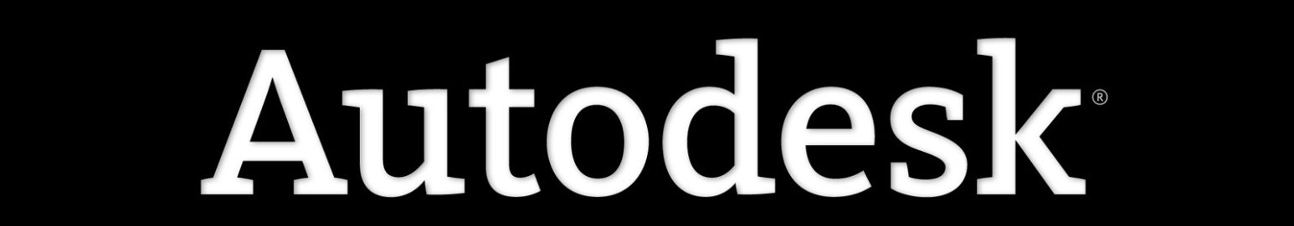
Notes:
Thank you!
Questions?

